Slide 1
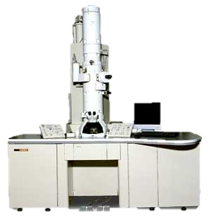
VIRTUAL ELECTRON MICROSCOPE
VIRTUAL ELECTRON MICROSCOPE
If you are viewing this message you must switch to “SLIDE SHOW” mode or use the “F5” key to switch to slide show mode
Click Here to Begin to Use the Electron Microscope

Slide 2
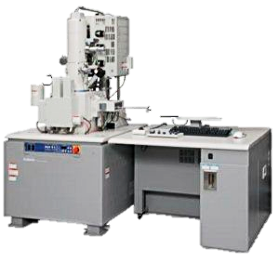
Stem Cells
Choose one of the specimens provided on the left to load into the electron microscope.
Once viewing the specimen you can magnify the image by clicking on the yellow MAGNIFY button on the scope.
Blood Cells
Nerve
Magnify
END EXERCISE

Slide 3
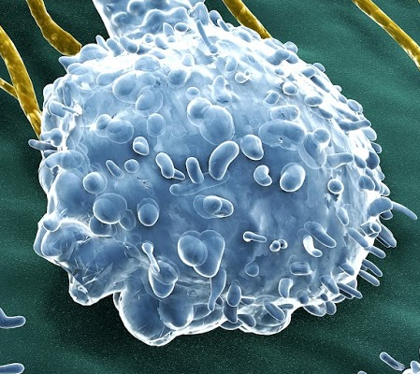
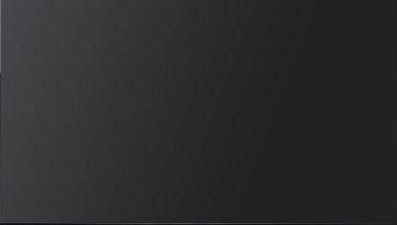

Stem Cells
Blood Cells
Nerve
Magnify
Human stem cells with a single T-cell
1) How many stem cells can you count?
2) Which of the cells are larger the stem cells or the T-cell
END EXERCISE

Slide 4
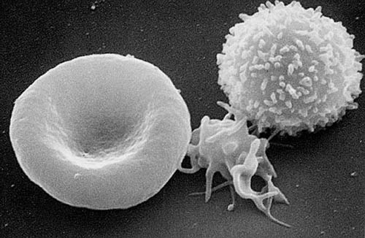
Stem Cells
Blood Cells
Nerve
Magnify
Red blood cell, platelet, white blood cell
3) Which cell is the largest?
4) Describe the shape of the Red Blood cell
END EXERCISE

Slide 5
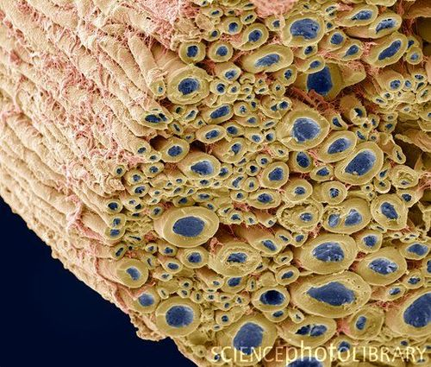
Stem Cells
Blood Cells
Nerve
Magnify
Nerve bundle with axons (blue) and myelin sheaths (yellow)
5) What do you think the pinkish strands are around the nerve fibers
6) Does the electron microscope allow a higher degree of magnification than the light microscope? Why?
END EXERCISE

