Slide 1
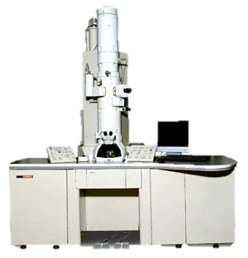
VIRTUAL ELECTRON MICROSCOPE
VIRTUAL ELECTRON MICROSCOPE
If you are viewing this message you must switch to “SLIDE SHOW” mode or use the “F5” key to switch to slide show mode
Click Here to Begin to Use the Electron Microscope

Slide 2
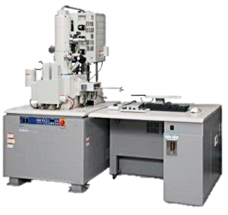
Tongue Bacteria
Choose one of the specimens provided on the left to load into the electron microscope.
Once viewing the specimen you can magnify the image by clicking on the yellow MAGNIFY button on the scope.
Staphylococcus
Avian Flu Virus
Magnify
END EXERCISE

Slide 3
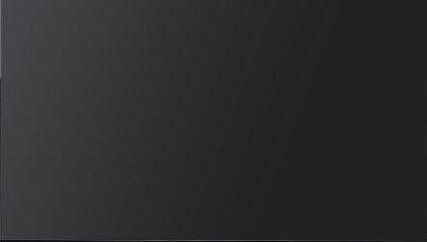
Tongue Bacteria
Staphylococcus
Avian Flu Virus
Magnify
Bacteria on the surface of the tongue
1) How many bacteria do you think are on the image?
2) Describe the different shapes of the bacteria that are visible.
END EXERCISE

Slide 4
Tongue Bacteria
Staphylococcus
Avian Flu Virus
Magnify
Methyllin resistant Staphylococcus aureus (purple) being ingested by macrophage (blue)
3) Which cell is the largest between the macrophage and the bacteria?
4) Describe the shape of the bacteria.
END EXERCISE

Slide 5
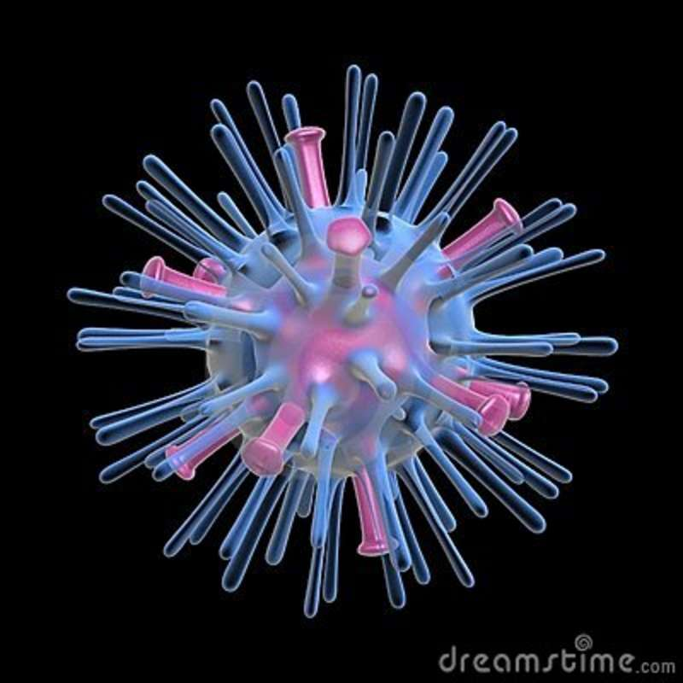
Tongue Bacteria
Staphylococcus
Avian Flu Virus
Magnify
Avian Flu Virus
5) Why do you think the virus has so many spikes on it?
6) Does the electron microscope allow a higher degree of magnification than the light microscope? Why?
END EXERCISE

